Slide 1
INF10025
Data Management and Analytics
Lecture 10 – Part 2
NoSQL databases
JSON

Slide 2
Relational Databases vs NoSQL databases
What is a Relational Database?
In a relational database, every table has a schema.
Every column has a defined size and data types
Each row in the table must conform the table design.
Tables are related to each other using foreign keys
Data duplication is eliminated
One piece of information is ideally stored once in the database
  If a piece of data changes, then ideally it only needs to be changed once.
We can use SQL to search for / retrieve data

Slide 3
Non Relational Databases
A NoSQL database is a non-relational database
There are different types of NoSQL databases. E.g.
  key value stores such as Redis, Azure Table Storage
  Column-based stores like Cassandra, Druid
  Graph databases like NEO4, AllegroGraph, ArangoDB
  Document databases like MongoDB, Azure DocumentDB.
We will concentrate on Document Databases
  A document is NOT a word processing document!
  It is NOT a .pdf document or a spreadsheet document!
  A document database stores entities as documents,
  meaning JSON (pronounced Jason) documents
JSON documents are similar to XML files.
JSON documents do not require a DocumentDB
JSON existed before DocumentDB databases arrived

Slide 4
What is JSON?
JSON (JavaScript Object Notation) (pronounced Jason)
A syntax for passing around objects that contain
  name/value pairs
  arrays
  other objects.
{"my_it_skills": {
"programming": [
{"name": "Visual Basic",
"yearstarted": "2010"
},
{"name": "JavaScript",
"yearstarted": "2013"
} ],
"database":[
{"name": "SQL",
"yearstarted": "2013"
} ]
}}
Curly braces { } act as containers
Square brackets [ ] hold arrays
  Array elements are separated by commas
Names and values are separated by a colon
Names and values surround by quotes
Human readable
Hierarchical (can store values within values)
These terms are interchangeable
Name / Value pair
Key – Value pair
Attribute – Value pair

Slide 5
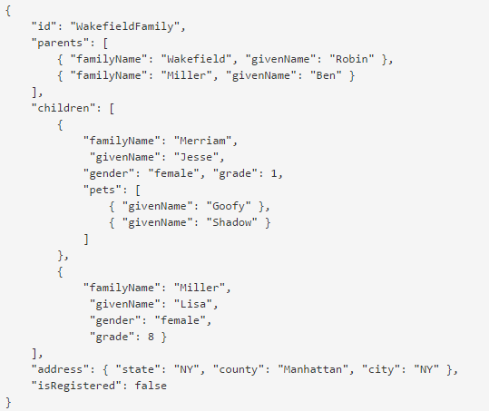
Another example of a JSON document

Slide 6
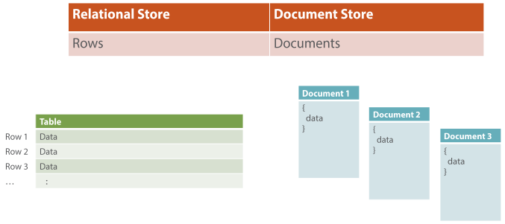
Rows vs Documents
RDBMS: Data is stored in Rows.
  3 customers requires 3 rows
DocumentDB: Data is stored in multiple Documents
- 3 customers requires 3 documents *
* This is flexible
Diagram - Leonard Lobel, lennilobel.wordpress.com

Slide 7
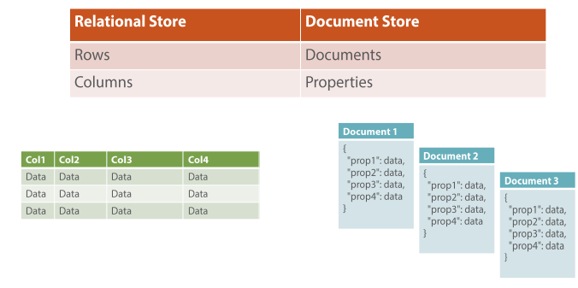
Columns vs Properties
RDBMS: Each row consists of multiple Columns.
DocumentDB: Each document consists of multiple Properties
Diagram - Leonard Lobel, lennilobel.wordpress.com

Slide 8
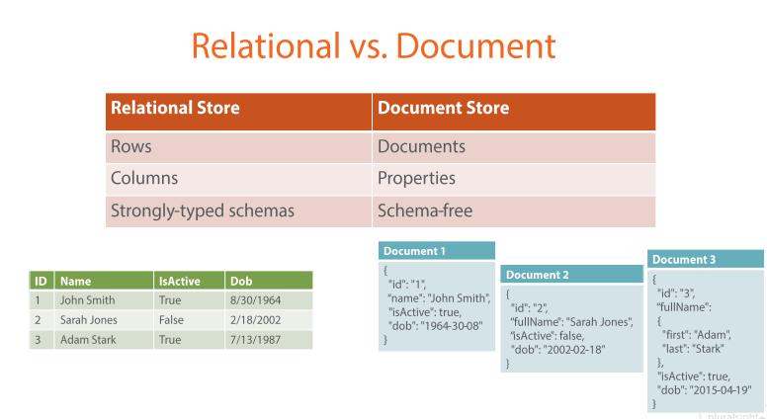
Documents are schema free.
RDBMS: Each row must conform to the schema
DocumentDB: Each document may use any properties (name/value pairs)
Document 3 has additional properties for the customer's name
Each document must have an ID property.
Diagram - Leonard Lobel, lennilobel.wordpress.com

Slide 9
Document properties are indexed
DocumentDB: As each document is added to the database,
every property is automatically indexed.
This means that retrieval speeds for any data is very quick
Diagram - Leonard Lobel, lennilobel.wordpress.com

Slide 10
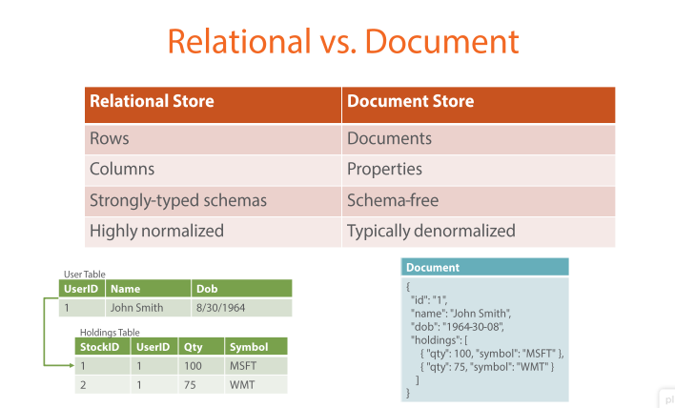
Normalised vs Denormalised
RDBMS: Tables have foreign keys to form relationships between tables
Tables must be joined when during queries. There is performance overhead.
DocumentDB: Each document is denormalised.
'Holdings' data is stored in the same document as customers data.
Queries are simple to write and fast. Fewer Joins.
Diagram - Leonard Lobel, lennilobel.wordpress.com

Slide 11
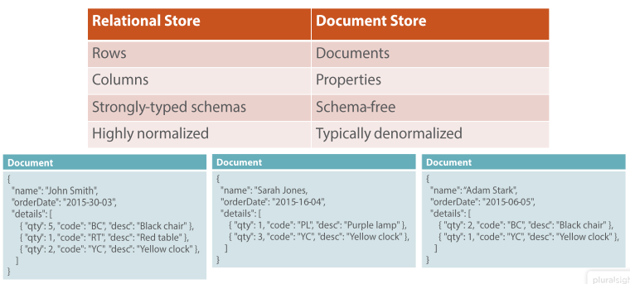
Redundant Data
RDBMS: Redundant Data is eliminated
DocumentDB: Documents contain redundant data.
The description of product "BC" is repeated in many documents
Diagram - Leonard Lobel, lennilobel.wordpress.com

Slide 12
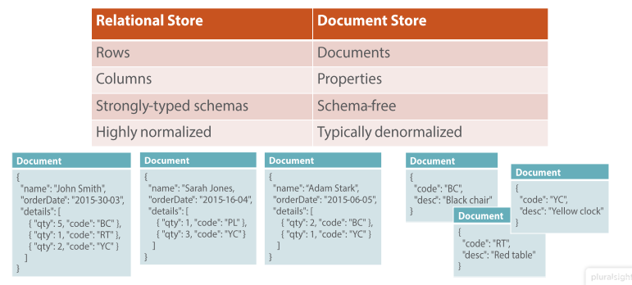
Some documents can be normalised
DocumentDB: The design of documents is flexible
You may choose to create a M:1 relationship between documents
Here product details are stored as separate documents
If you find that you are always generating M:1 relationships, then
perhaps you shouldn't be using a documentDB
Diagram - Leonard Lobel, lennilobel.wordpress.com

Slide 13
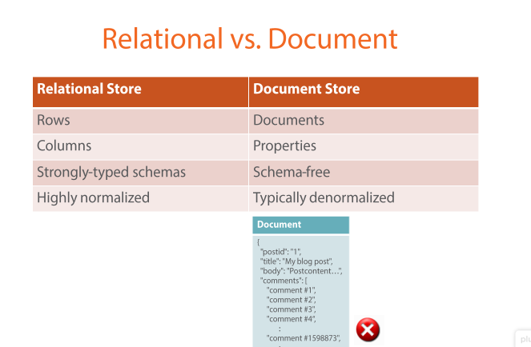
Parent / Child relationships
DocumentDB: This document contains a M:1 relationship within a single document
Similar to earlier examples.
This is reasonable when there is a limit to the maximum number
of comments (children)
Diagram - Leonard Lobel, lennilobel.wordpress.com

Slide 14
Infinite children is a problem
DocumentDB: It is impractical to attempt to store an infinite number of children
in a single document
Diagram - Leonard Lobel, lennilobel.wordpress.com

Slide 15
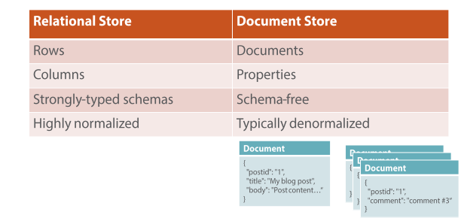
Documents can be normalised
DocumentDB: The design of documents is flexible
You may choose to create a M:1 relationship between documents
Here comments are stored as separate documents
Diagram - Leonard Lobel, lennilobel.wordpress.com

Slide 16
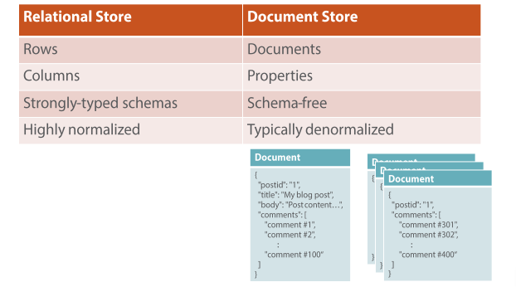
Combine aspects of normalised and denormalised
DocumentDB: This design stores multiple 100 comments (children) per document
Diagram - Leonard Lobel, lennilobel.wordpress.com

Slide 17
DocumentDB and replication.
RDBMS: Often a single copy of the database. You wouldn't expect that a bank customer has multiple versions of his/her bank balance throughout multiple databases.
DocumentDB: Are often replicated. This allows them the satisfy high volume of queries and searches. Processes in place for changes to a document to be propagated to multiple replicas of the database.
Diagram - Leonard Lobel, lennilobel.wordpress.com

Slide 18
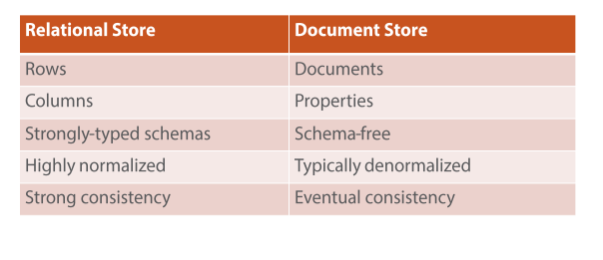
Consistency
RDBMS: Enforce strong consistency.
After data is updated, every user sees new updated values immediately
- no one should see an out of date value of the customers bank balance!
DocumentDB: Eventual consistency.
After data is updated (e.g. customer address)
          - changes are made in multiple documents (that store the address)
          - changes are propagated through multiple replicated databases
          All data is eventually updated.
          Does it matter if not everyone can see absolutely latest comment?
.
Diagram - Leonard Lobel, lennilobel.wordpress.com

Slide 19
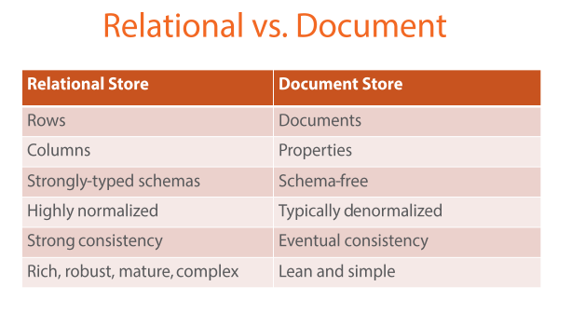
Summary
NoSQL databases are simple by design.
  Can achieve performance that surpasses relational databases.
  Can achieve massive scale (which RDBMS systems find difficult and expensive)
Diagram - Leonard Lobel, lennilobel.wordpress.com

Slide 20
Summary
Microsoft launched Azure DocumentDB on in, 2015
It is a NoSQL document database.
It's massively scalable
It uses schema-free JSON documents.
DocumentDB is a document database service designed for modern mobile and web applications.
It offers fast reads and writes, schema flexibility, and the ability to easily scale a database up and down on demand.
It does not assume or require any schema for the JSON documents it indexes.
DocumentDB automatically indexes every property in a document as soon as the document is added to the database.
DocumentDB enables complex ad-hoc queries
  Every document is instantly queryable
  Search on any property anywhere within the document hierarchy.

